Slide 1
Introduction to Cows
Exploring the World of Cows

Slide 2
What are Cows?
Cows are domesticated animals that are primarily raised for their milk, meat, and other products.
They belong to the Bovidae family and are known for their gentle nature and distinctive appearance, including their large stomachs and prominent horns.
Cows are commonly found on farms and play a vital role in agriculture and food production.

Slide 3
Types of Cows
There are various breeds of cows, each with unique characteristics and purposes.
Examples include Holsteins known for their high milk production, Angus for their quality beef, and Jerseys for their rich milk content.
Different types of cows are bred for specific traits and are adapted to various climates and environments.

Slide 4
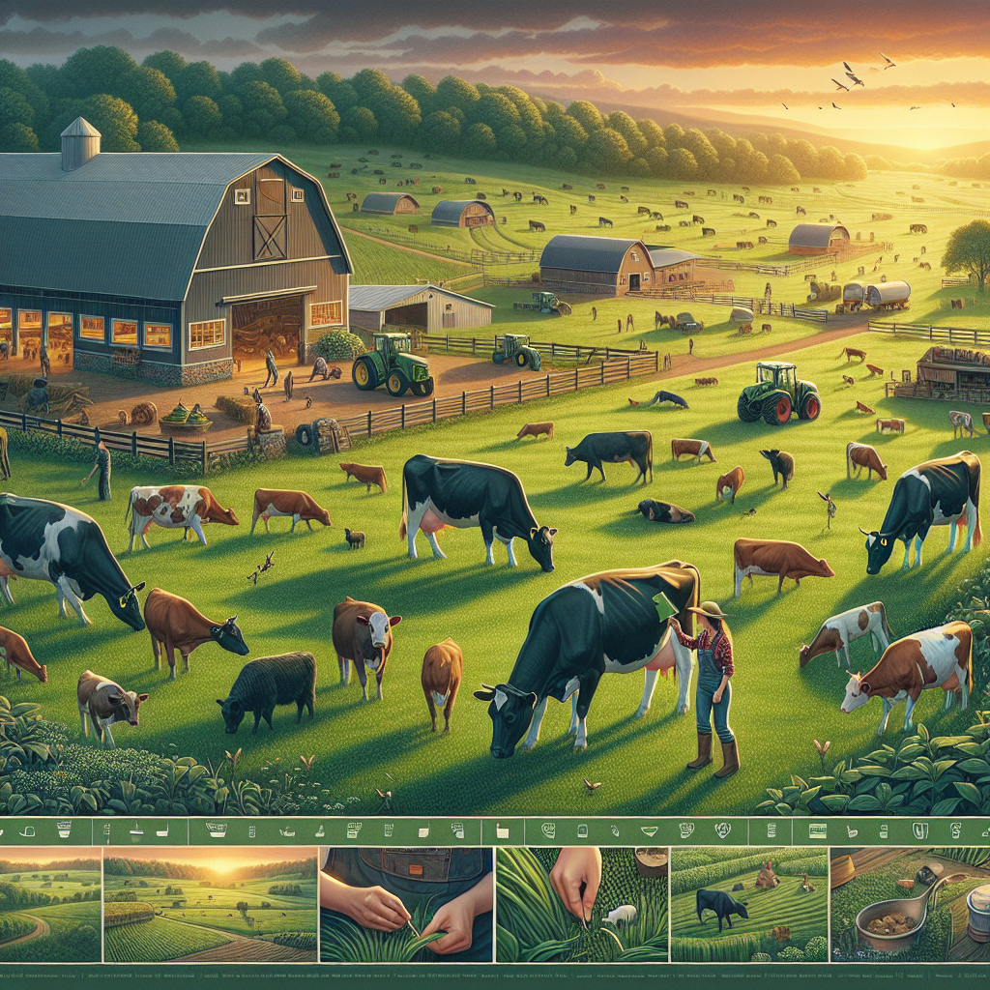
Caring for Cows
Proper care and management are essential for the health and well-being of cows.
This includes providing nutritious feed, clean water, shelter, and veterinary care.
Farmers also need to ensure proper hygiene, disease prevention, and overall welfare of the animals.
Cows on a Farm

Slide 5
Uses of Cows
Cows have diverse uses in various industries and cultures around the world.
They are a source of dairy products such as milk, cheese, and yogurt, as well as meat products like beef and veal.
Additionally, cows provide materials such as leather, gelatin, and even fuel through bio-gas production.

Slide 6
Symbolism of Cows
Cows hold symbolic significance in many cultures and religions.
In Hinduism, cows are revered as sacred symbols of life and fertility, often associated with the goddess Kamadhenu.
In other traditions, cows symbolize abundance, nourishment, and peaceful coexistence with nature.

Slide 7
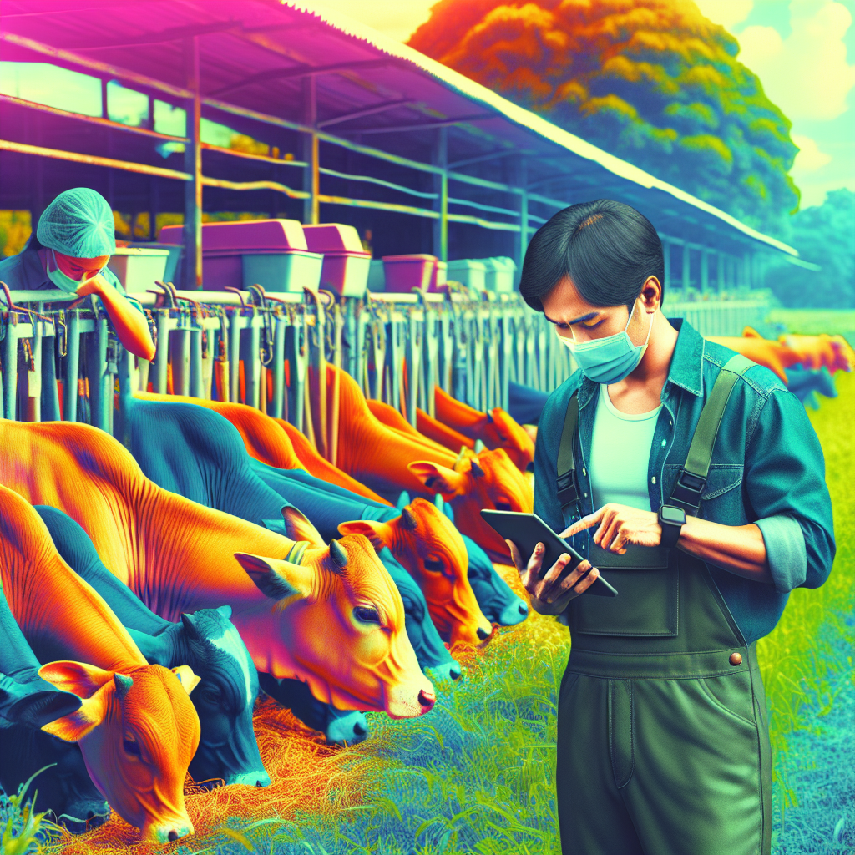
Cow Breeding Practices
Selective breeding is used to improve the genetics and traits of cows for specific purposes.
This practice involves choosing breeding stock with desirable characteristics such as milk production, meat quality, or disease resistance.
Over time, selective breeding has led to the development of specialized breeds with enhanced productivity and performance.
Selective Breeding of Cows

Slide 8
Challenges in Cow Farming
Modern cow farming faces challenges such as environmental impact, animal welfare concerns, and disease management.
Issues like antibiotic resistance, waste disposal, and climate change effects are also important considerations in sustainable cow agriculture.
Farmers and researchers are exploring innovative solutions to address these challenges while ensuring the well-being of cows and the environment.

Slide 9
Future of Cow Farming
The future of cow farming is evolving with advancements in technology, sustainability practices, and consumer preferences.
Precision farming, digital monitoring, and alternative feeds are shaping the next generation of cattle production.
Innovations in genetics, robotics, and environmental stewardship will continue to drive the future of sustainable and efficient cow farming.

Slide 10
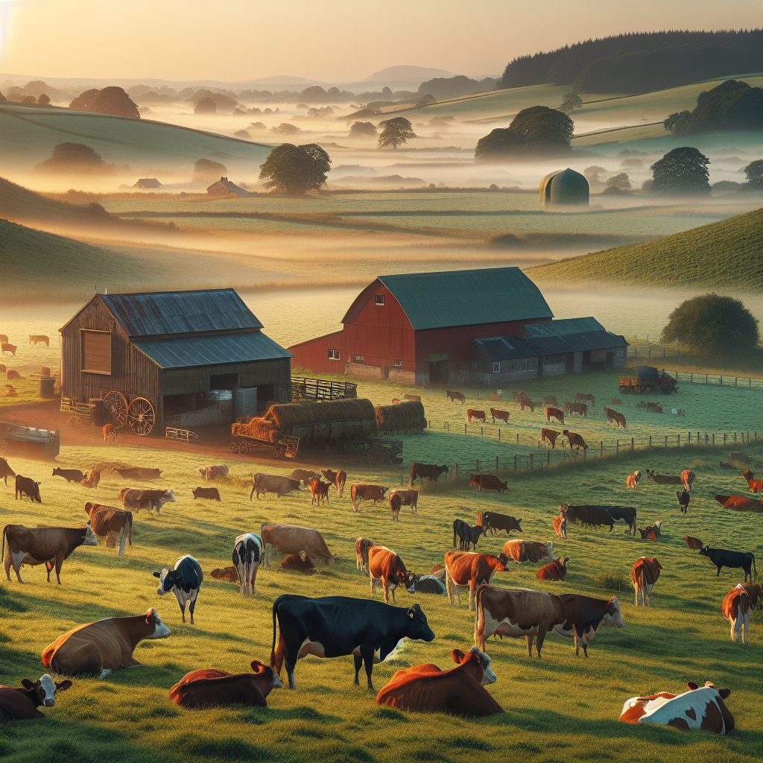
Conclusion
Cows play a critical role in agriculture, food production, and cultural traditions worldwide.
Through proper care and management, cows provide essential resources for human consumption and various industries.
As we look to the future, sustainable practices and technological innovations will shape the continued success of cow farming.
Cows Grazing in a Field

Slide 11
References
1. Hoffman, D., & Miller, J. (2019). The Dairy Cow. Farm Press.
2. Smith, L., & Brown, A. (2020). Beef Cattle Breeding. Agriculture Journal.
3. Kumar, R., & Patel, S. (2018). Sustainable Livestock Farming. Ecology Research.

Slide 12
Thank You
Thank you for exploring the world of cows with us!
We hope you've gained valuable insights into the significance and practices of cow farming.
Feel free to reach out if you have any questions or want to learn more about these fascinating animals.

